Slide 1
Computational Intelligence Case Study- Review:2
Group-6
Gopika Narayanan - 17021
Sai Sudha Panigrahi - 17051
Sayannah P.B. - 17150

Slide 2
Problem Identification
Title assigned : Text Query of Images
To use the technology of computational intelligence to search and display the images based on the text query given by the user.

Slide 3
Introduction
Content-based image retrieval, also known as query by image content (QBIC) and content-based visual information retrieval (CBVIR), is the application of computer vision techniques to the image retrieval problem, that is, the problem of searching for digital images in large databases.

Slide 4
Need for text query
Database technologies for pictorial applications were discussed for the first time in that era and the researchers got attraction for this domain since then. Former image retrieval techniques were not that intelligent and sophisticated and they were not able to search for images based on its visual features instead those techniques were based on text-based metadata of images. All images stored in the database were first tagged with the metadata and then images were searched based on the image metadata. Text-based image retrieval methods were used for conventional database applications. They were used with lot of business applications and purposes but increasing usage and volume of digital images created performance and accuracy issues for text-based image retrieval methods. New methods proposed for image retrieval considered color, texture, and shapes of objects in an image.

Slide 5
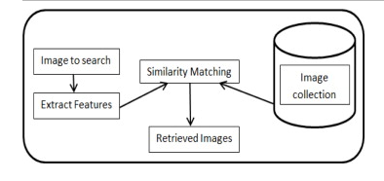
Applications
Content based Image searching techniques used in Google.
E-commerce sites for fashion
Querying images from large databases.

Slide 6
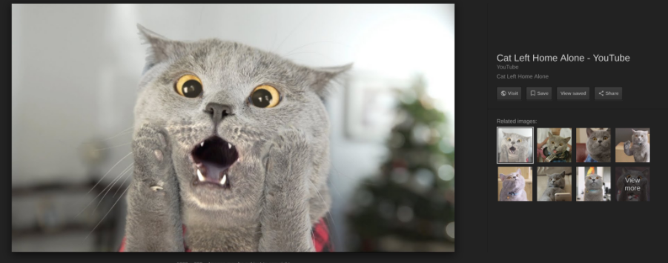
Dataset Description
The dataset consists of google images of around 50 animals.
Each animal set contains roughly 500 images.
Data captured are the image, title, and caption for the image.

Slide 7
Tools Identification
Google Colab
Packages used: Keras,PIL,Image,Sklearn,Numpy,Pandas,Tensorflow
Model used:VGG16
Activation function used: LeakyRelu,SoftMax, Relu
Language: Python 3

Slide 8
Identifying Neural Network
Building the model
The model consists of two parts
Text model
Image model
Our objective is to train these two models jointly such that they will share the same vector space.Final parameters in the overall model : optimizer='adam', loss='binary_crossentropy'
• Text model: Embedding, Dense, Dropout

Slide 9
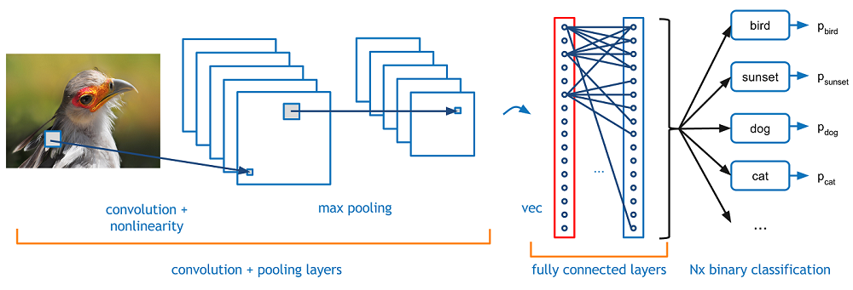
• Image model: Conv2D, MaxPooling2D, Flatten, Dense

Slide 10
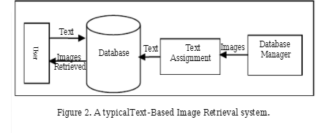

Slide 11
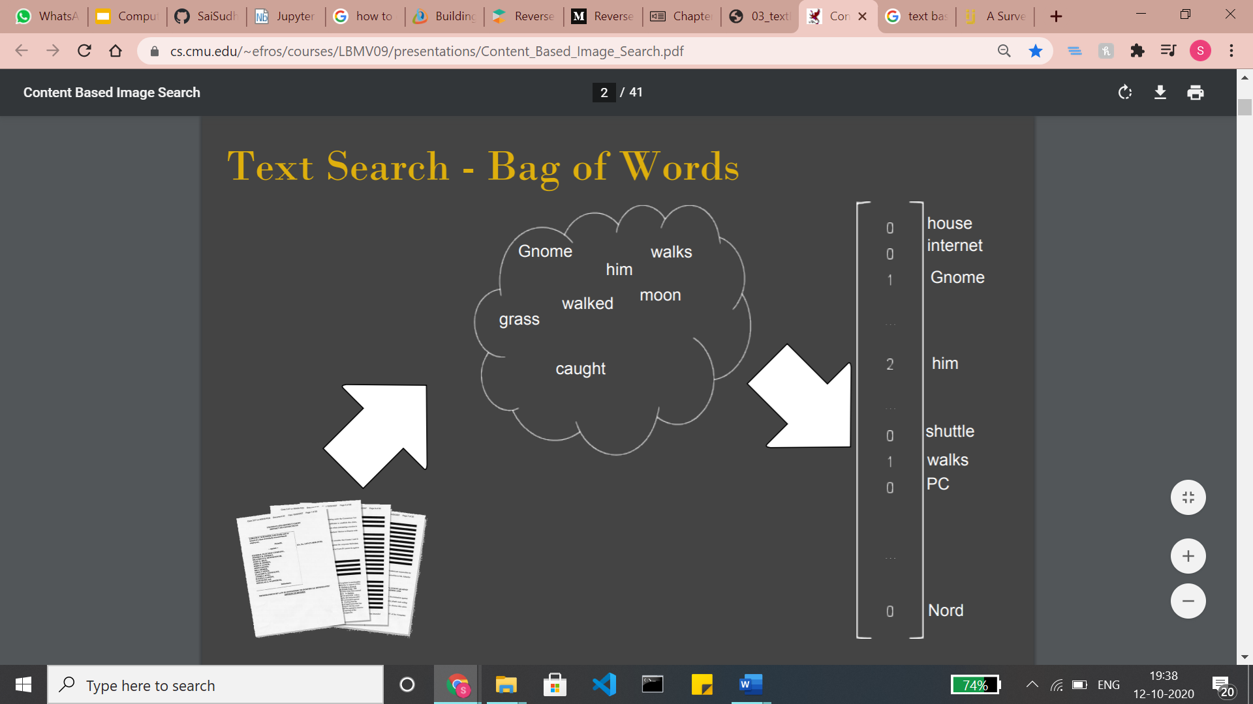

Slide 12
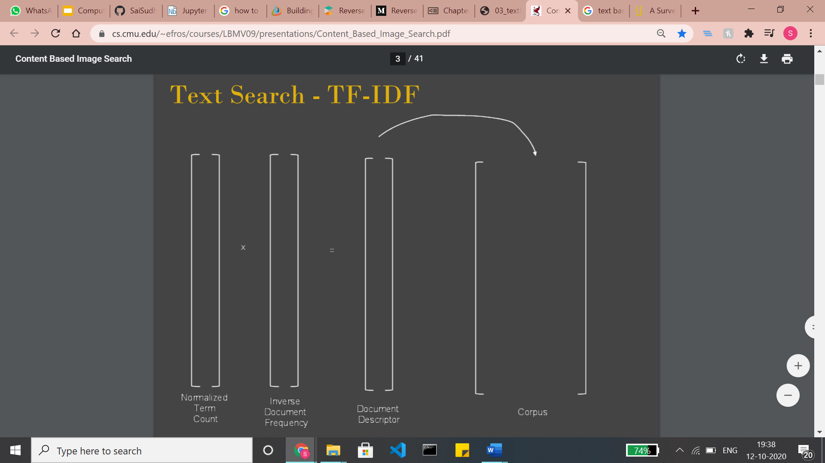

Slide 13
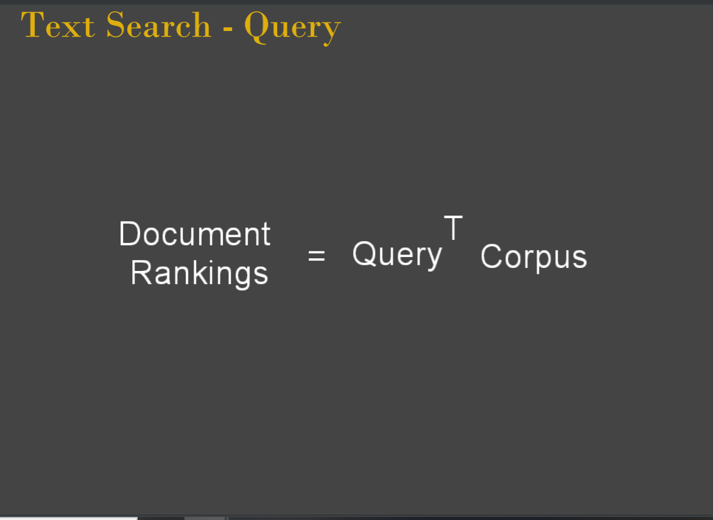

Slide 14
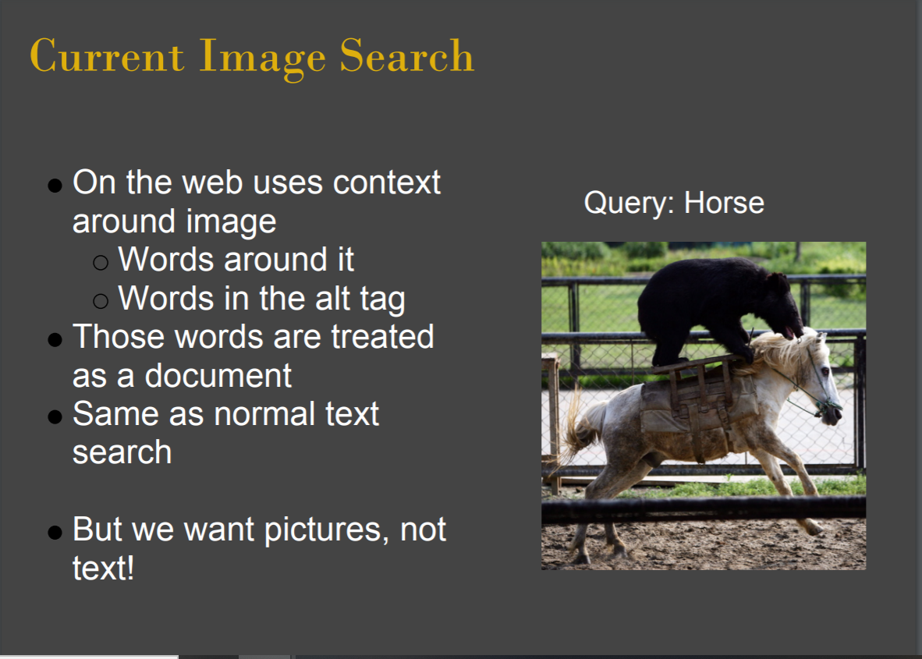

Slide 15
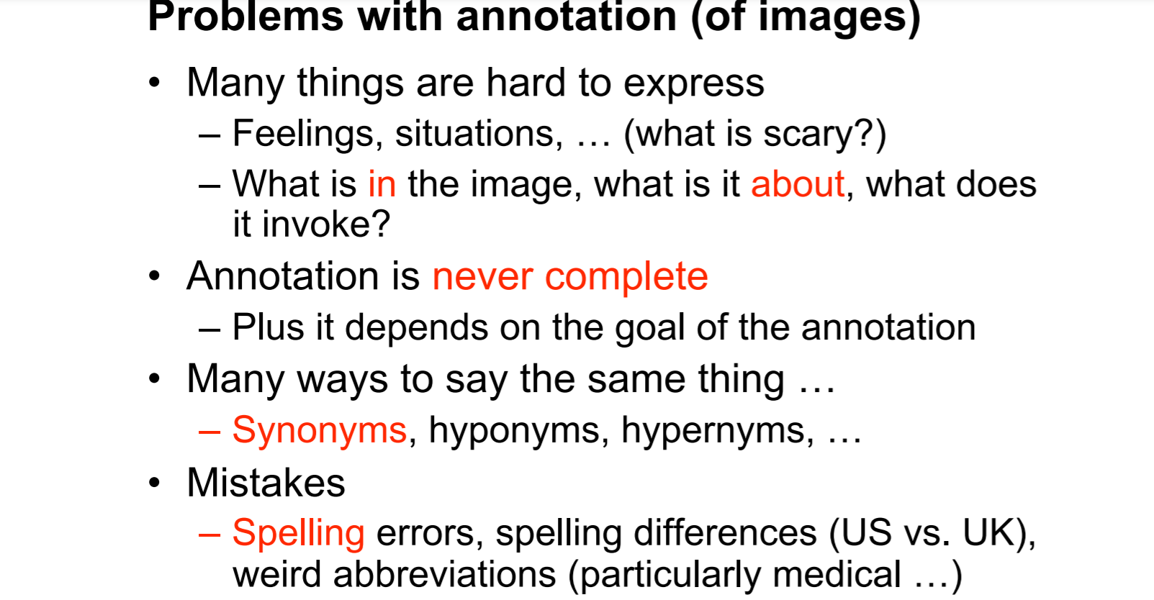
Problems with annotation (of images) • Many things are hard to express – Feelings, situations, … (what is scary?) – What is in the image, what is it about, what does it invoke? • Annotation is never complete – Plus it depends on the goal of the annotation • Many ways to say the same thing … – Synonyms, hyponyms, hypernyms, … • Mistakes – Spelling errors, spelling differences (US vs. UK), weird abbreviations (particularly medical …)

Slide 16
Method 1: Convolutional Neural Network(Review-1)
https://drive.google.com/file/d/14-IAK7jqg0jWw-hVmQBeqYvoqCu1-Kuw/view?usp=sharing

Slide 17
Review:2
Three algorithms are used for this review in the following way:
Text/Image preprocessing using fuzzy algorithm
Triple Neural Network(Method :2)
Conversion of input/output image to its child images using Genetic algorithm

Slide 18
Fuzzy preprocessing techniques (Gopika)
https://drive.google.com/file/d/1MdcyzcG3po82zguPf4C7-rIO1LUQBHnP/view?usp=sharing
Human brain is capable of making excellent decisions using imprecise & incomplete sensory information provided by the perceptive organs. Fuzzy theory provides a systematic calculus to deal with such information linguistically and perform numerical computations using linguistic labels in the form of membership functions. Fuzzy inference system (FIS) when selected properly can effectively model the human expertise in the specific application.
In this we are trying to enhance the contrast of the image using different methods such as histogram technique, fuzzy method, gray-scale technique etc.

Slide 19
Triple Neural Network (Sayannah)
Triplet loss is a loss function for machine learning algorithms where a baseline (anchor) input is compared to a positive (truthy) input and a negative (falsy) input. The distance from the baseline (anchor) input to the positive (truthy) input is minimized, and the distance from the baseline (anchor) input to the negative (falsy) input is maximized . The first formulation equivalent to the triplet loss was introduced (without the idea of using anchors) for metric learning from relative comparisons by M. Schultze and T. Joachims in 2003.
https://colab.research.google.com/drive/1ts53MNL9-n7ixmF2vQWo9cvgyLnbTALZ?usp=sharing

Slide 20
Genetic algorithm Implementation ( Sai Sudha)
Reproducing Images using a Genetic Algorithm
The project accepts an image as input. This image can have one or more channels (i.e. the image could be binary, gray, or color, such as RGB).
The genetic algorithm (GA) starts from a randomly generated image of the same shape as the input image. This randomly generated image is evolved, using crossover and mutation, using GA until it reproduces an image similar to the original one.

Slide 21
Genetic Algorithm Steps
GA is a random-based optimization technique that has a number of generic steps that are generally followed to solve any optimization problem. These steps are then customized to the problem being solved.
Data Representation
Initial Population
Fitness Calculation
Parent Selection
Crossover
Mutation

Slide 22
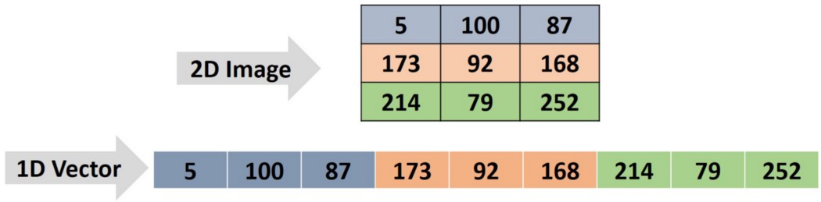
Data Representation
The first task for an optimization problem using GA is to think about the best way to represent the data. GA accepts the chromosome (i.e. solution) as a 1D row vector. The input image will not be 1D. The image may be 2D if it’s a binary or a gray image.

Slide 23
code
def img2chromosome(img_arr):
chromosome = numpy.reshape(a=img_arr, newshape=(functools.reduce(operator.mul, img_arr.shape)))
return chromosome
def chromosome2img(chromosome, img_shape):
img_arr = numpy.reshape(a=chromosome, newshape=img_shape)
return img_arr

Slide 24
Initial Population
GA starts an initial population, which is a group of solutions (chromosomes) to the given problem. These solutions are randomly generated. The function not only returns a single chromosome but a group of chromosomes. It’s specified as the second argument n_individuals, which defaults to 8 if not specified:
def initial_population(img_shape, n_individuals=8):
init_population = numpy.empty(shape=(n_individuals,
functools.reduce(operator.mul, img_shape)),
dtype=numpy.uint8)
for indv_num in range(n_individuals):
# Randomly generating initial population chromosomes genes values.
init_population[indv_num, :] = numpy.random.random(
functools.reduce(operator.mul, img_shape))*256
return init_population

Slide 25
Fitness Calculation
GA starts with a number of bad solutions that are randomly generated. GA is based on the idea that evolving bad solutions might return better solutions. For every generation, the GA selects the best of the solutions in the current population and evolves them, hoping to return better solutions.This is done using a fitness function. Each chromosome is applied to this function and a number is returned. The higher the number, the better the solution. This is known as a maximization function.
def fitness_fun(target_chrom, indiv_chrom):
quality = numpy.mean(numpy.abs(target_chrom-indiv_chrom))
quality = numpy.sum(target_chrom) - quality
return quality

Slide 26
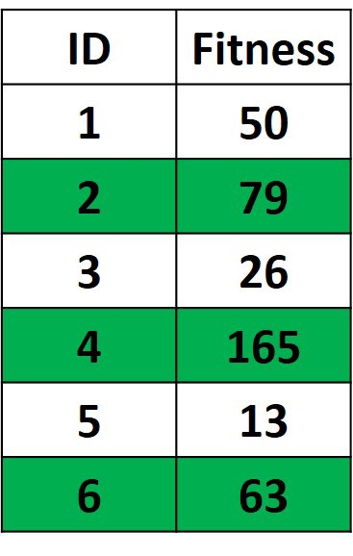
Parent Selection
The parents selected from a given population are the best solutions within it. When we say “best solutions”, we’re referring to the solutions with the highest fitness values.

Slide 27
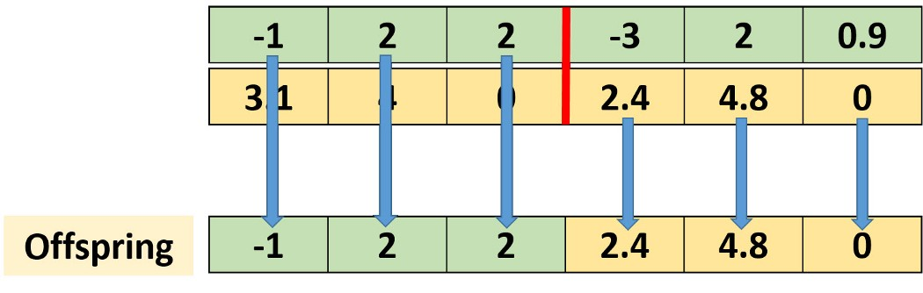
Crossover
The next figure shows an example in which single-point crossover is applied between 2 parents in order to create an offspring. Single-point crossover works by selecting a point at the chromosome. Genes before this point are selected from one parent, and genes after it are selected from the other parent. As a result, the offspring shares genes from both parents.

Slide 28
Code
def crossover(parents, img_shape, n_individuals=8):
new_population = numpy.empty(shape=(n_individuals, functools.reduce(operator.mul, img_shape)), dtype=numpy.uint8)
#Previous parents (best elements).
new_population[0:parents.shape[0], :] = parents
# Getting how many offspring to be generated. If the population size is 8 and number of parents mating is 4, then number of offspring to be generated is 4.
num_newly_generated = n_individuals-parents.shape[0]
# Getting all possible permutations of the selected parents.
parents_permutations = list(itertools.permutations(iterable=numpy.arange(0, parents.shape[0]), r=2))
# Randomly selecting the parents permutations to generate the offspring.
selected_permutations = random.sample(range(len(parents_permutations)),
num_newly_generated)

Slide 29
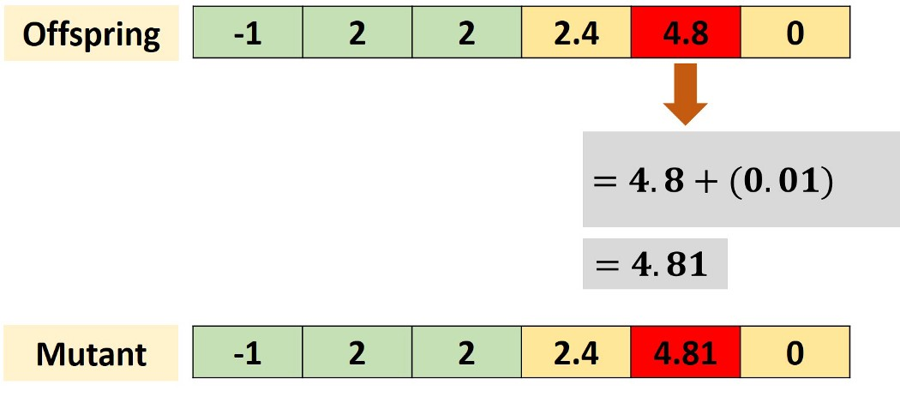
Mutation
The mutation operation selects some genes within the chromosome and then randomly changes their values. It’s implemented according to the mutation() function listed below. It accepts the population returned by the crossover() function, number of parents, and the percent of the genes to be changed.

Slide 30
Code
def mutation(population, num_parents_mating, mut_percent):
for idx in range(num_parents_mating, population.shape[0]):
# A predefined percent of genes are selected randomly.
rand_idx = numpy.uint32(numpy.random.random(size=numpy.uint32(mut_percent/100*population.shape[1]))*population.shape[1])
# Changing the values of the selected genes randomly.
new_values = numpy.uint8(numpy.random.random(size=rand_idx.shape[0])*256)
# Updating population after mutation.
population[idx, rand_idx] = new_values
return population

Slide 31
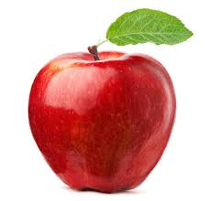
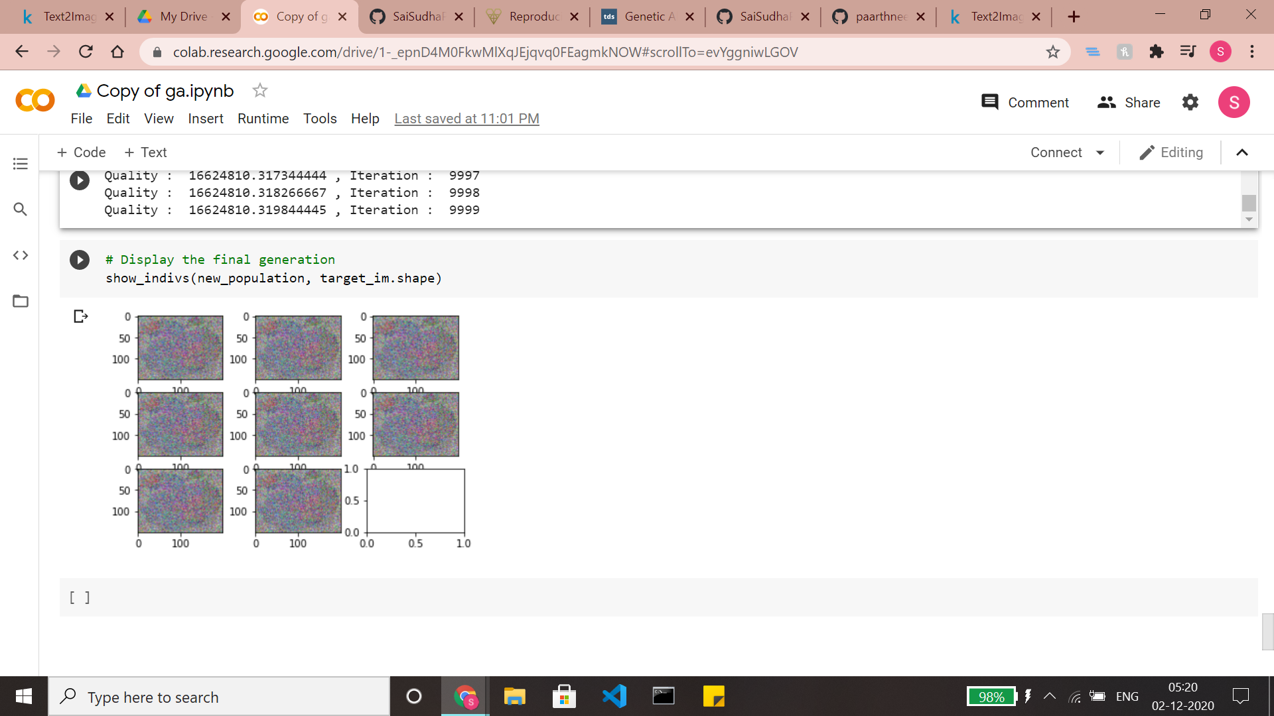
Results before fine tuning parameters

Slide 32
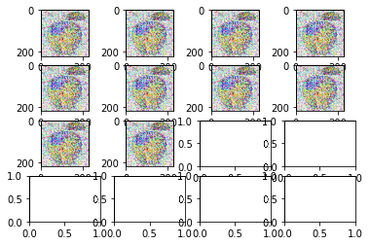
Increased Quality after fine tuning parameters

Slide 33
Conclusions
In this work, we have experimented with two models such as Conventional Neural Networks and Triplet Neural Network. for the text query of images. We did this in order to compare the performance of traditional neural networks and an improvised one. Traditional neural net takes in text queries passed after minimal preprocessing and resultant images are generated. In order to improve the image quality and validation of image search we have used fuzzy and triple neural nets. We have used a fuzzy algorithm for the image enhancement process. We have used a Genetic algorithm for producing a set of child images from a target image and fine tuned the parameters for enhanced results.

Slide 34


